Slide 1
Computational Visualization Method for Drug Discovery
Student: Shy Alon
Supervisor: Dr. Abraham Yosipof

Slide 2
Motivation
Clinical Research
Preclinical Research
Drug Discovery and Development
FDA Review
10,000 Compounds
Single Compound
The cost of a new drug is estimated at 5.5 billion USD
Out of which the discovery costs 1.25 billion USD

Slide 3
Research Hypothesis
There exists a computational cost effective method for the drug discovery stage.
Such a method will be able to predict the biological activity of a compounds prior to their synthesis

Slide 4
Application
Cell Membrane
G-protein-coupled receptors (GPCRs) are the largest single superfamily of proteins
GPCRs represent ~45% of current drug targets and thus have excellent potential for drug discovery

Slide 5

Pharma Research

Slide 6
Pharma Research
30% of total cost of an approved new compound is due to the drug discovery phase and the pre-clinical phase.
It takes 24.3 targets to create a hit and 19.4 hits to create a lead - one out of 471 targets become a lead.
These numbers can be significantly improved.

Slide 7
Pharma Research

Slide 8
The Model
Input Database
Selection of Features
Run t-SNE
Optimization Engine (GA)
Calculate Fitness Function
Select Best Model

Slide 9
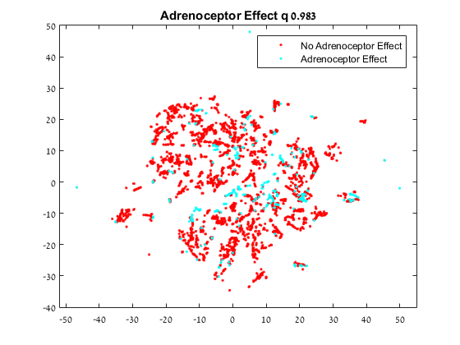
Result Example

Slide 10
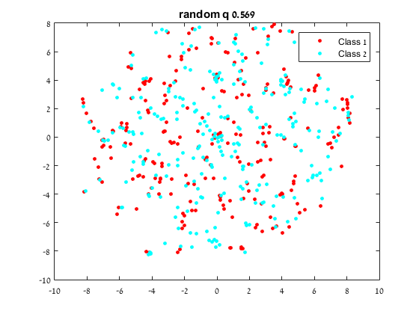
Verification – Random Result

Slide 11
Result Summary
 | Q-1 | Q-3 | Q-5 | Trust
Dopamine | 0.965 | 0.965 | 0.961 | 0.087
Adrenoceptors | 0.983 | 0.985 | 0.984 | 0.077
Histamine | 0.967 | 0.963 | 0.964 | 0.078
Muscarinic | 0.993 | 0.993 | 0.993 | 0.076
Serotonin | 0.938 | 0.934 | 0.921 | 0.090
Average | 0.9692 | 0.9680 | 0.9646 | 0.0816

Slide 12
Validation
A compound with unknown effect is very likely to have the same effect as their nearest neighbor.
Choosing by a nearest neighbor has a very high probability of choosing a compound with the same effect.
Compounds are classified by nearest neighbor.

Slide 13
Conclusions
An algorithm for drastically reducing costs for pre-clinical phase has been demonstrated as effective.
Limitations exist because of algorithm complexity (time and space).

Slide 14
Future Work
Distributed implementation of the algorithm
Use of lower complexity alternatives to t-SNE

